Slide 1


Quantum Neural Network based Distinguisher for Differential Cryptanalysis on Simplified Block Ciphers
National Cryptography Contest $2022$
$$2022.09.15$$

Slide 2

Contents
01
Introduction
02
Background
Quantum neural network
Neural network-based distinguisher
03
Proposed Method
Dataset preparation
Design of quantum neural network-based distinguisher for simplified block cipher
04
Experiments and Evaluation
Details of proposed quantum neural distinguisher
Quantum-classical Hybrid Network vs. Classical Neural Network
Quantum advantage
05
Conclusion
National Cryptography Contest $2022$

Slide 3

01
Introduction
Motivation
Many researches on distinguisher based on deep learning have been conducted.
Quantum advantages (i.e. fewer parameters and higher accuracy) can be achieved by using quantum neural networks compared to classical neural networks.
Let’s apply a quantum neural network for a deep learning-based distinguisher, and get quantum advantages!
Let’s do this!
Deep learning-based
distinguisher
Apply a quantum neural network
instead of classical neural network
Quantum neural network-based distinguisher
National Cryptography Contest $2022$

Slide 4
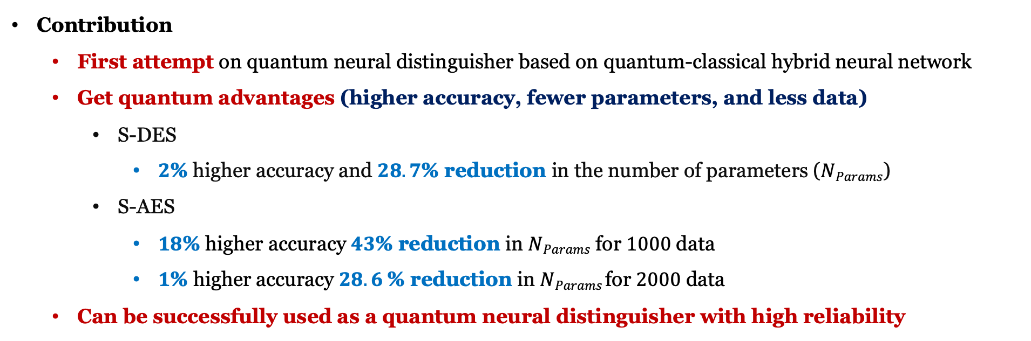
01
Introduction
Contribution
First attempt on quantum neural distinguisher based on quantum-classical hybrid neural network
Get quantum advantages (higher accuracy, fewer parameters, and less data)
S-DES
$2$% higher accuracy and $28.7$% reduction in the number of parameters ($NParams$)
S-AES
$18$% higher accuracy $43$% reduction in $NParams$ for $1000$ data
$1$% higher accuracy $28.6$% reduction in $NParams$for $2000$ data
Can be successfully used as a quantum neural distinguisher with high reliability
National Cryptography Contest $2022$

Slide 5
Contents
01
Introduction
02
Background
Classical and quantum neural network
Neural network-based distinguisher
03
Proposed Method
Dataset preparation
Design of quantum neural network-based distinguisher for simplified block cipher
04
Experiments and Evaluation
Details of proposed quantum neural distinguisher
Quantum-classical Hybrid Network vs. Classical Neural Network
Quantum advantage
05
Conclusion
National Cryptography Contest $2022$

Slide 6
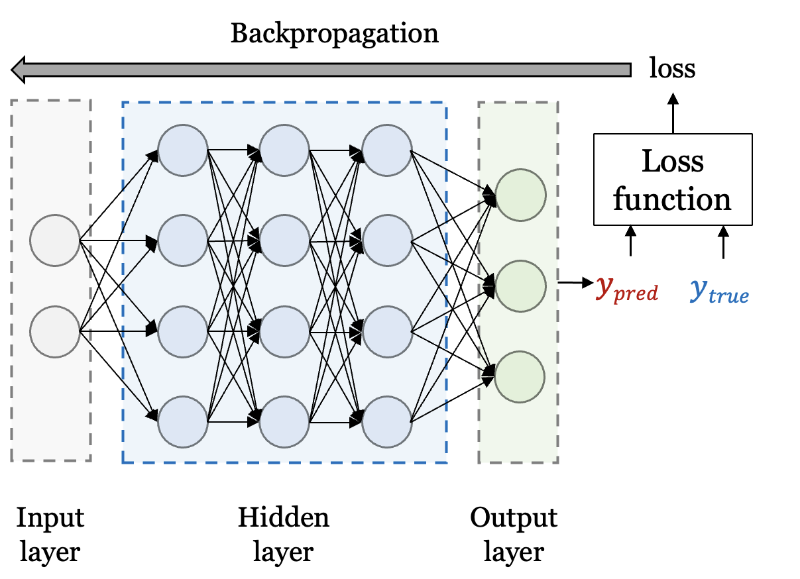

02
Background
Classical neural network
Prediction for data by learning the features of the input data
Neurons in each layer perform “multiply-add” using the neuron values and weights in the previous layer (connected).
Calculate loss after going through all layers
Update the weights of the neural network (NN) to minimize the loss
National Cryptography Contest $2022$

Slide 7
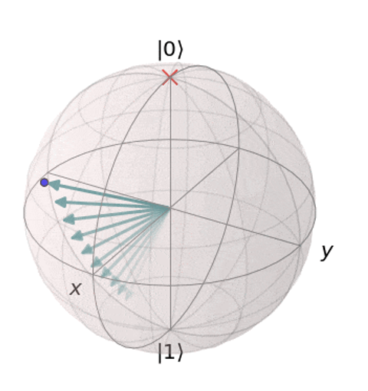
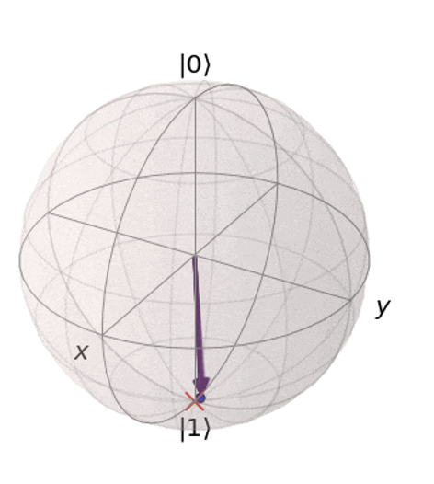






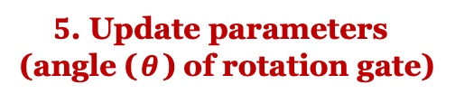



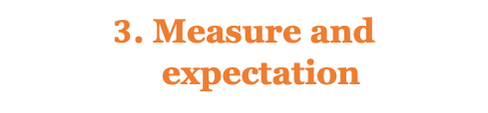

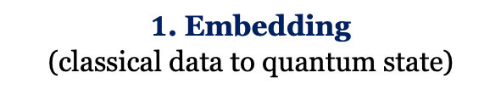


02
Background
Qubit
Quantum neural network (QNN)
Neural network using quantum mechanical phenomena (entanglement, superposition)
Changing the training process of classical NN to a quantum circuit
Classical and quantum NN can be combined (Hybrid)
A part of the NN is composed of a quantum circuit (Using quantum circuits as layers)
Training of hybrid QNN
Changing the state of a qubit by applying rotation gate (Rx, Ry, Rz, CRx, CRy, CRz)
Update the angle of rotation gate for changing qubit state
$1$. Embedding (classical data to quantum state)
$2$. Parameterized circuit
$3$. Measure and expectation
$4$. Calculate loss
$$qubit 0$$
H
Ry($0.4$)
Rx($0.8$)
$$⋯$$
Loss function
[$0.4, 0.35$]
[$0.7$]
Classical data
$qubit 1$
H
Ry($0.35$)
$$⋯$$
$5$. Update parameters (angle ($θ$) of rotation gate)
National Cryptography Contest $2022$

Slide 8
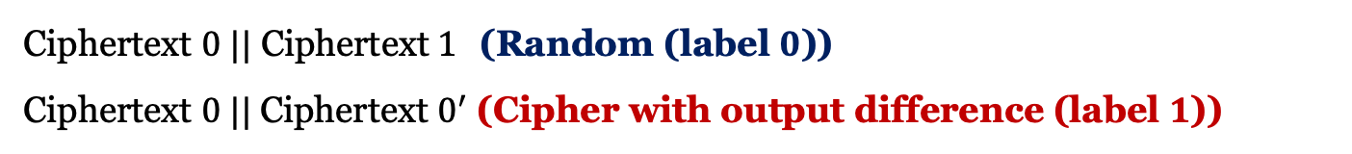
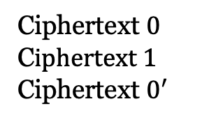
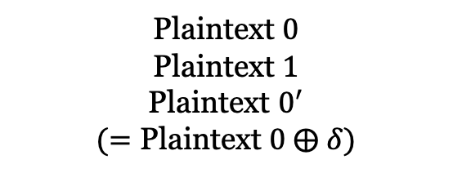
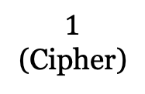

02
Background
Neural network-based Distinguisher
Plaintext $0$
Plaintext$1$
Plaintext $0^{′}$ $$(=\text{Plaintext} 0 ⨁ δ)$$
Ciphertext $0 ||$ Ciphertext$1$ (Random (label $0$))
Ciphertext $0 ||$Ciphertext $0^{′}$ (Cipher with output difference (label $1$))
Input difference
Encryption
Neural network-based distinguisher
$$0$$
(Random)
$$1$$
(Cipher)
Ciphertext $0$
C$iphertext 1$
Ciphertext $0^{′}$
Binary classification
Data preparation
National Cryptography Contest $2022$

Slide 9
Contents
01
Introduction
02
Background
Quantum neural network
Neural network-based distinguisher
03
Proposed Method
Dataset preparation
Design of quantum neural network-based distinguisher for simplified block cipher
04
Experiments and Evaluation
Details of proposed quantum neural distinguisher
Quantum-classical Hybrid Network vs. Classical Neural Network
Quantum advantage
05
Conclusion
National Cryptography Contest $2022$

Slide 10
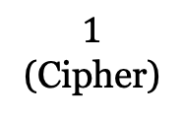
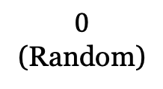
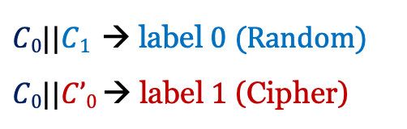

03
Proposed Method
Quantum neural network-based distinguisher for simplified block cipher
Data preparation
Input difference
Quantum-classical hybrid NN
Plaintext $p0, p1, p^{′}0$($p0$, $p1$($≠p0 ⨁ δ$),$p′0 \text{=} p0$ $⨁ δ)$
Input data
Classical layer
Input layer
Encryption (S-DES, S-AES)
Output difference
Quantum circuit
Hidden layer
Ciphertext $C0, C1, C’0$ ($Δ=C0 ⨁$ $C’0$)
Classical layer
Output layer
$C0||C1$ → label $0$ (Random)
$C0||C’0$ → label $1$ (Cipher)
Bit
$$0$$
(Random)
$$1$$
(Cipher)
National Cryptography Contest $2022$

Slide 11
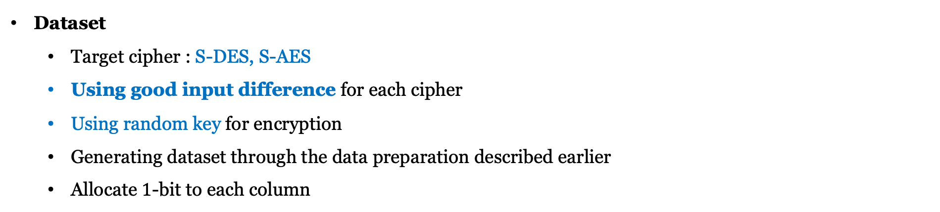
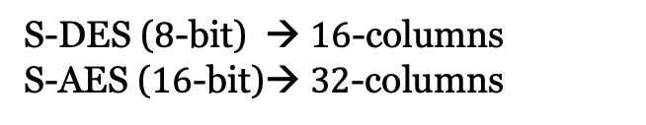

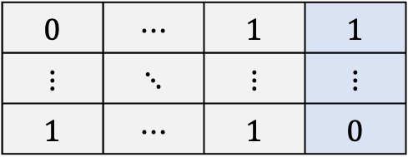
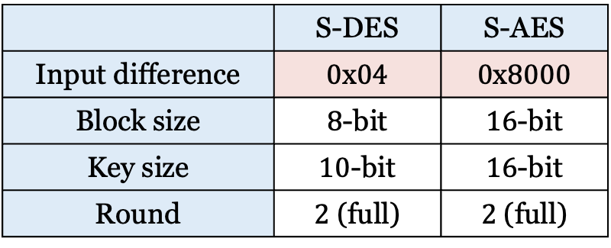
03
Proposed Method
Dataset
Target cipher : S-DES, S-AES
Using good input difference for each cipher
Using random key for encryption
Generating dataset through the data preparation described earlier
Allocate $1$-bit to each column
$C0||C1$ $or C0||C’0$
label
 | S-DES | S-AES
Input difference | $0$x$04$ | $0$x$8000$
Block size | $8$-bit | $16$-bit
Key size | $10$-bit | $16$-bit
Round | $2$ (full) | $2$ (full)
$$0$$ | $$⋯$$ | $$1$$ | $$1$$
$$⋮$$ | $$⋱$$ | $$⋮$$ | $$⋮$$
$$1$$ | $$⋯$$ | $$1$$ | $$0$$
S-DES ($8$-bit) → $16$-columns
S-AES ($16$-bit)→ $32$-columns
National Cryptography Contest $2022$

Slide 12
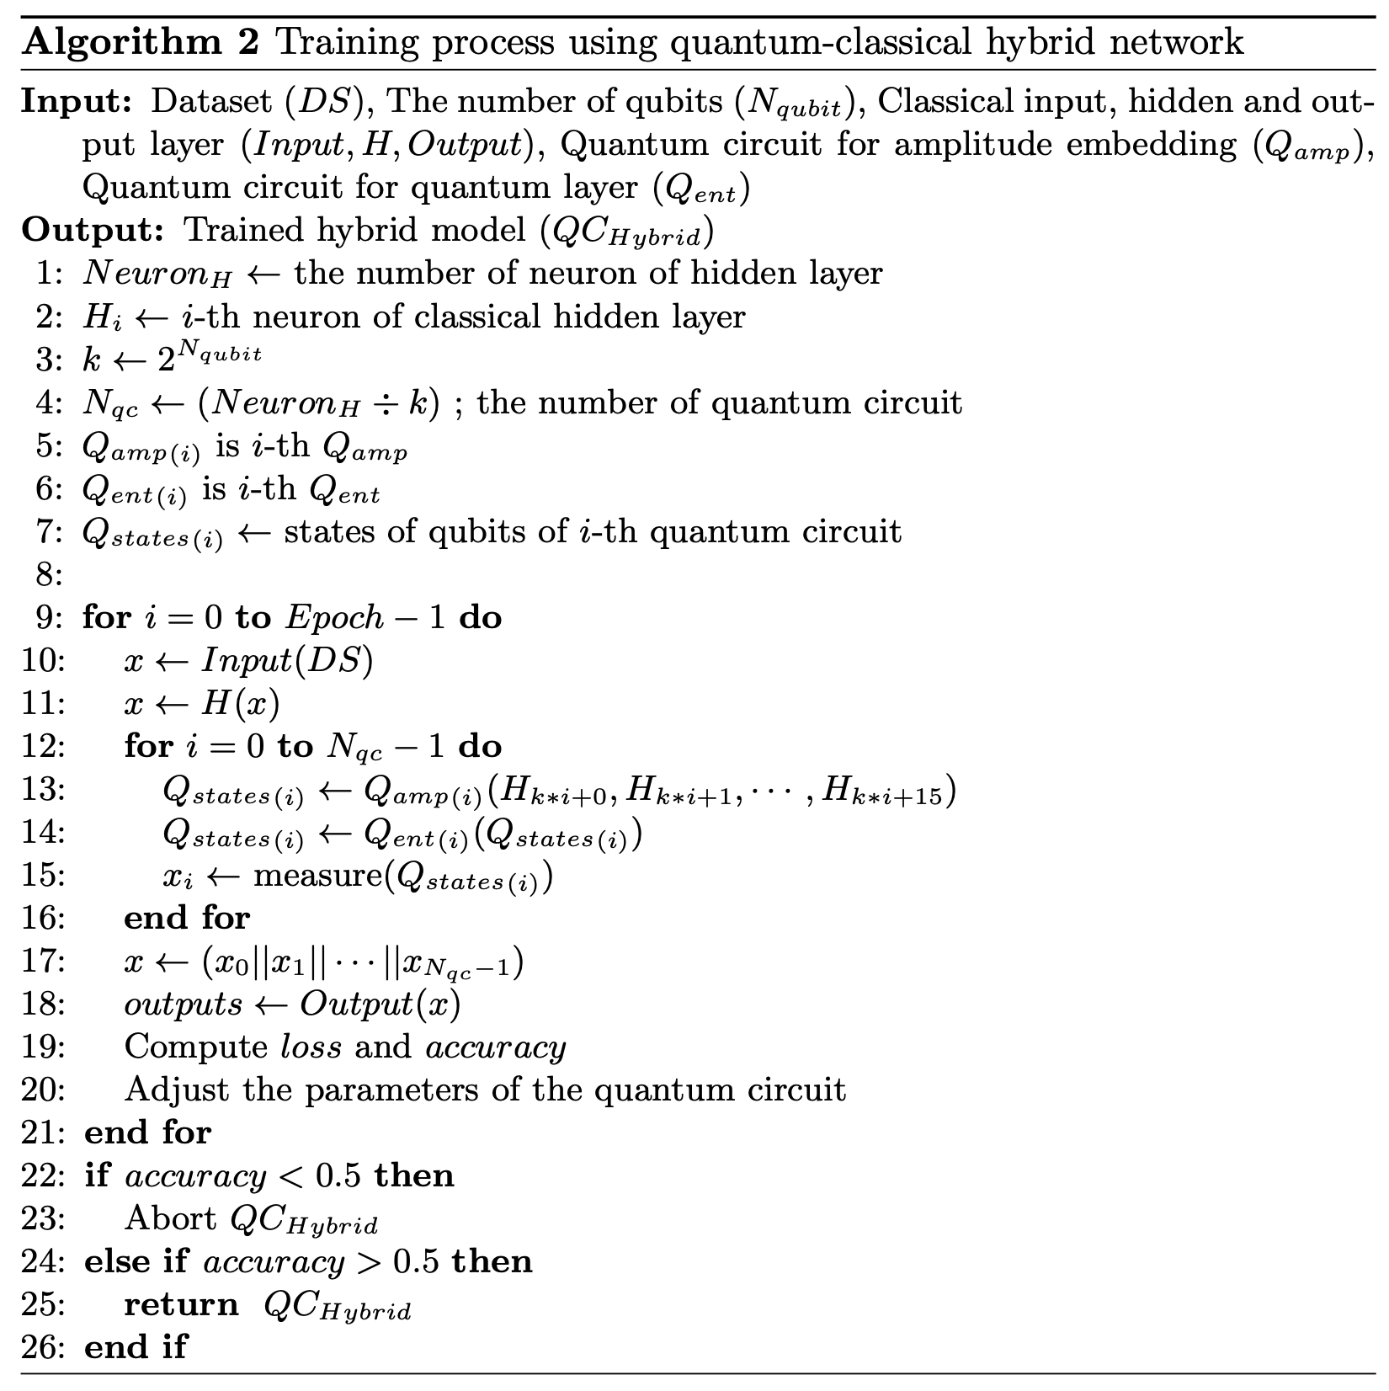
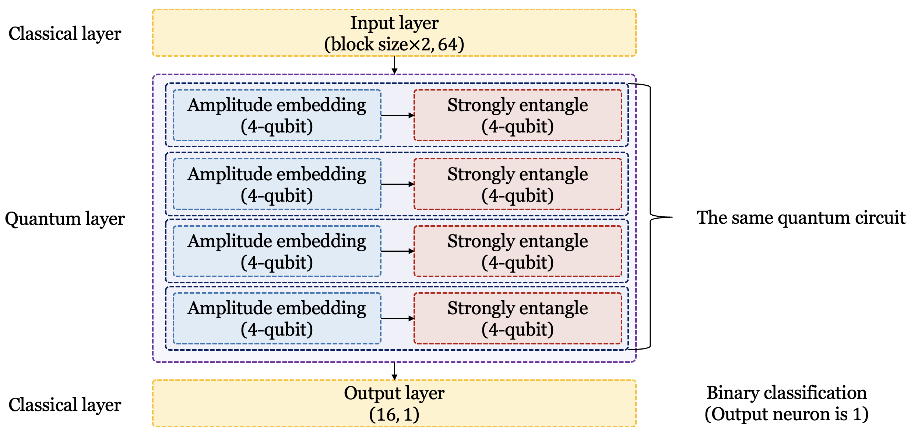
03
Proposed Method
Design of quantum neural distinguisher and training process
National Cryptography Contest $2022$

Slide 13
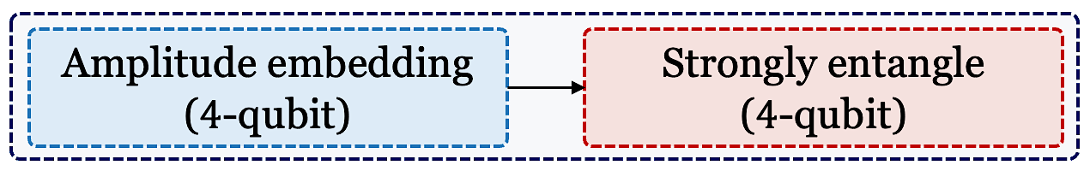
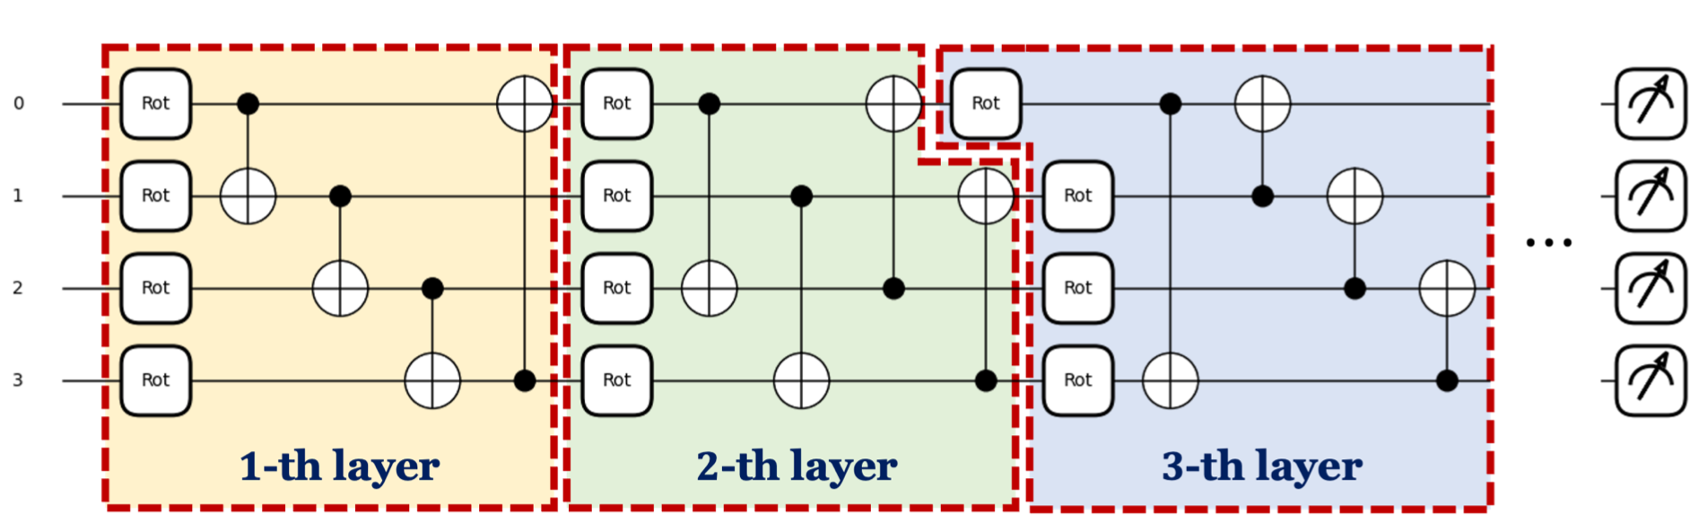
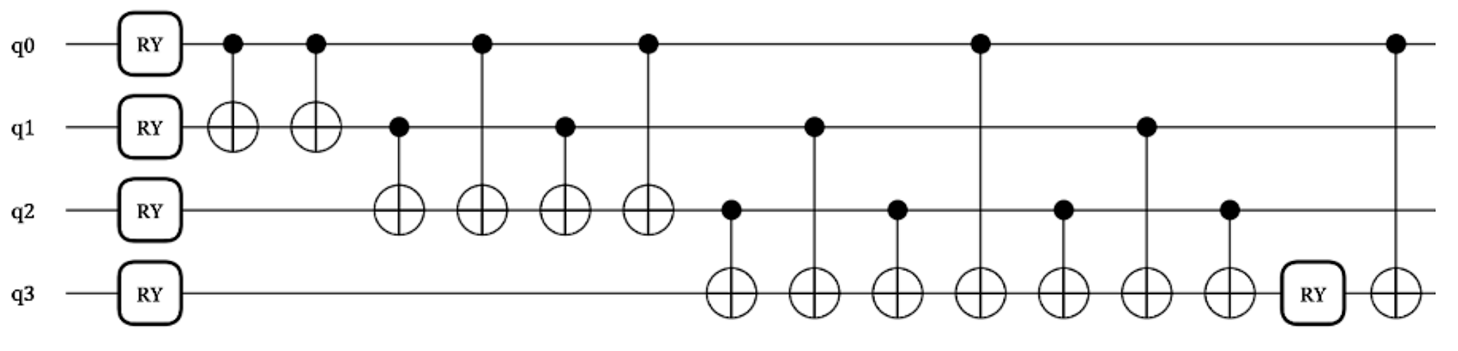
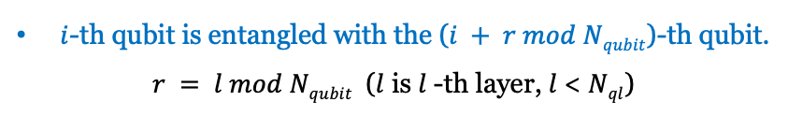
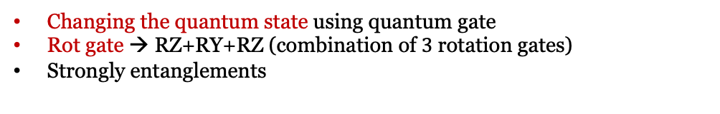
03
Proposed Method
Design of quantum circuit (quantum layer of hybrid NN)
Embedding
Parameterized circuit
Representing $16$ features using $4$-qubit
Changing the quantum state using quantum gate
Rot gate → RZ+RY+RZ (combination of $3$ rotation gates)
Strongly entanglements
RY : for rotation
CNOT : for entanglements
Classic data to the amplitude vector representing the state of the qubit
$i$-th qubit is entangled with the ($i + r mod Nqubit$)-th qubit.
$r = l mod Nqubit$ ($l$ is $l$-th layer, $l$< $Nql$)
National Cryptography Contest $2022$

Slide 14





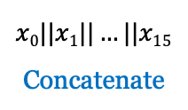
















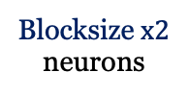



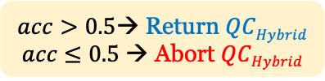

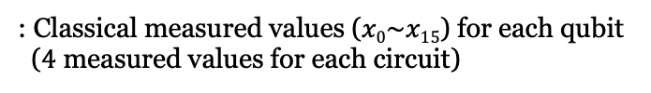





03
Proposed Method
Design of quantum neural distinguisher and training process
Measure all qubits
$$H0$$
: Classical measured values ($x0\sim x15$) for each qubit ($4$ measured values for each circuit)
$$16$$
$$(2^{N_{qubit}})$$
$$H1$$
$$x0$$
$$x1$$
$$⋮$$
$$x2$$
$acc>0.5$→ Return $QCHybrid$
$acc$ $≤0.5$ → Abort $QCHybrid$
*$N_{qubit}=4$
$$x3$$
$$Qamp0$$
$$Qent0$$
Blocksize$x2$
neurons
$$H15$$
$$64$$
neurons
$$x0||x1||…||x15$$
Concatenate
Accuracy ($acc$)
$$⋮$$
$$⋮$$
$$⋮$$
Loss
$$(NeuronH)$$
$$H48$$
$1$ neuron
Binary classification
$$H49$$
$$x12$$
$$16$$
$$x13$$
$$⋮$$
$$x14$$
Update parameters of $Qent$
$$x15$$
$$H63$$
$$Qamp3$$
$$Qent3$$
Input layer
Classical hidden layer
Quantum layer
Classical output layer
National Cryptography Contest $2022$

Slide 15
Contents
01
Introduction
02
Background
Quantum neural network
Neural network-based distinguisher
03
Proposed Method
Dataset preparation
Design of quantum neural network-based distinguisher for simplified block cipher
04
Experiments and Evaluation
Details of proposed quantum neural distinguisher
Quantum-classical Hybrid Network vs. Classical Neural Network
Quantum advantage
05
Conclusion
National Cryptography Contest $2022$

Slide 16
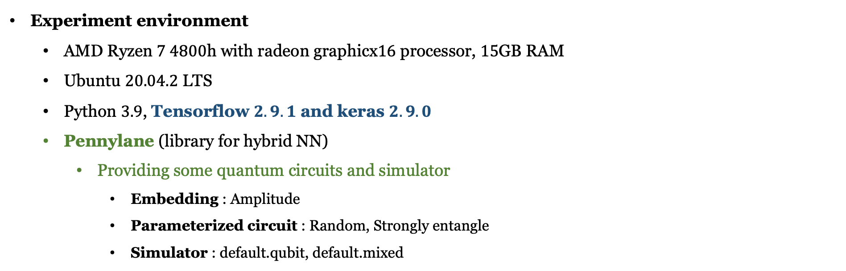
04
Experiment and Evaluation
Experiment environment
AMD Ryzen $7 4800$h with radeon graphicx$16$ processor, $15$GB RAM
Ubuntu $20.04.2$ LTS
Python $3.9$, Tensorflow $2.9.1$ and keras $2.9.0$
Pennylane (library for hybrid NN)
Providing some quantum circuits and simulator
Embedding : Amplitude
Parameterized circuit : Random, Strongly entangle
Simulator : default.qubit, default.mixed
National Cryptography Contest $2022$

Slide 17
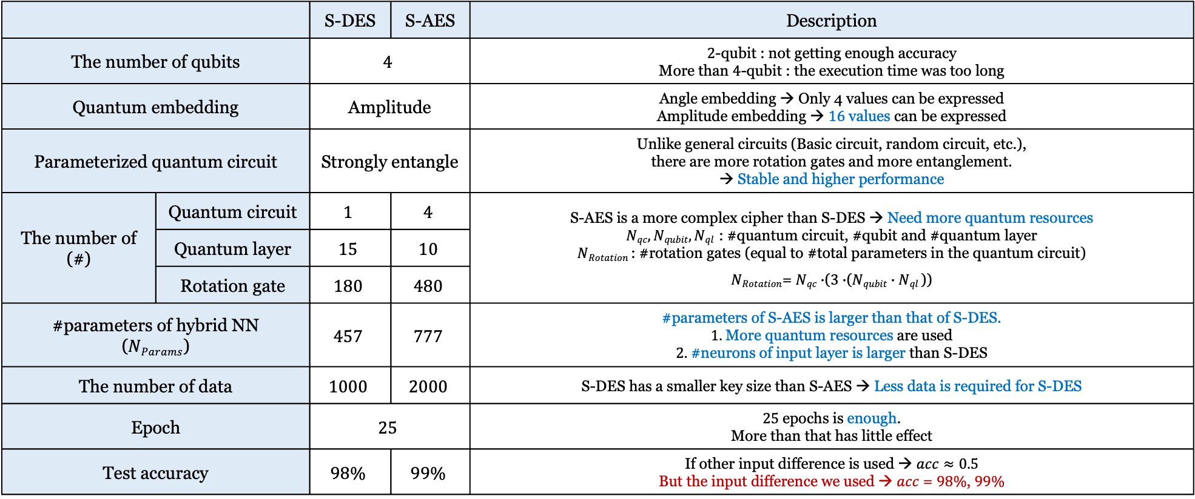
04
Experiment and Evaluation
Details of proposed quantum neural distinguisher
 |  | S-DES | S-AES | Description
The number of qubits |  | $$4$$ |  | $2$-qubit : not getting enough accuracy More than $4$-qubit : the execution time was too long
Quantum embedding |  | Amplitude |  | Angle embedding → Only 4 values can be expressed Amplitude embedding → $16$values can be expressed
Parameterized quantum circuit |  | Strongly entangle |  | Unlike general circuits (Basic circuit, random circuit, etc.), there are more rotation gates and more entanglement. → Stable and higher performance
The number of (#) | Quantum circuit | $$1$$ | $$4$$ | S-AES is a more complex cipher than S-DES → Need more quantum resources $Nqc, Nqubit, Nql$ : #quantum circuit, #qubit and #quantum layer $NRotation$ : #rotation gates (equal to #total parameters in the quantum circuit) $NRotation$= $Nqc∙$($3∙$($Nqubit$ $∙Nql$))
The number of | Quantum layer | $$15$$ | $$10$$
 | Rotation gate | $$180$$ | $$480$$
#parameters of hybrid NN ($NParams$) |  | $$457$$ | $$777$$ | #parameters of S-AES is larger than that of S-DES. $1.$More quantum resources are used $2.$ #neurons of input layer is larger than S-DES
The number of data |  | $$1000$$ | $$2000$$ | S-DES has a smaller key size than S-AES → Less data is required for S-DES
Epoch |  | $$25$$ |  | $25$epochs is enough. More than that has little effect
Test accuracy |  | $$98\%$$ | $$99\%$$ | If other input difference is used → $acc≈0.5$ But the input difference we used → $acc$ = $98\%$, $99\%$
National Cryptography Contest $2022$

Slide 18
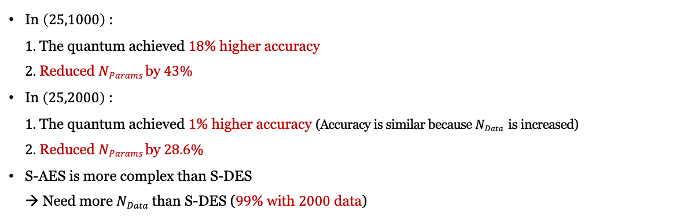
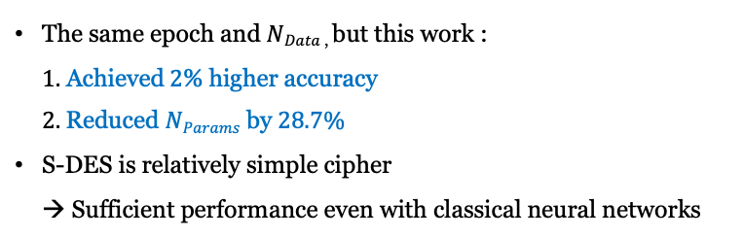
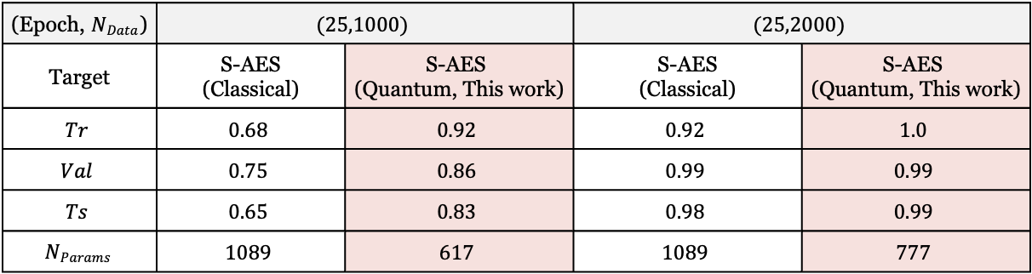

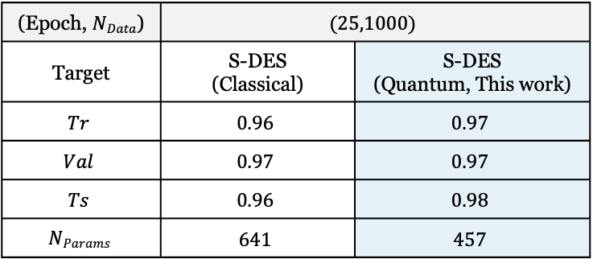

04
Experiment and Evaluation
Comparison with quantum-classical hybrid network and classical neural network
S-DES
S-AES
* $NData$ : # data, $Tr$/ $Val/$ $Ts$ : Accuracy of training/validation/test, $NParams$ : #parameters of hybrid NN
(Epoch, $NData$) | $$(25,1000)$$
Target | S-DES (Classical) | S-DES (Quantum, This work)
$$Tr$$ | $$0.96$$ | $$0.97$$
$$Val$$ | $$0.97$$ | $$0.97$$
$$Ts$$ | $$0.96$$ | $$0.98$$
$$NParams$$ | $$641$$ | $$457$$
(Epoch, $NData$) | $$(25,1000)$$ |  | $$(25,2000)$$
Target | S-AES (Classical) | S-AES (Quantum, This work) | S-AES (Classical) | S-AES (Quantum, This work)
$$Tr$$ | $$0.68$$ | $$0.92$$ | $$0.92$$ | $$1.0$$
$$Val$$ | $$0.75$$ | $$0.86$$ | $$0.99$$ | $$0.99$$
$$Ts$$ | $$0.65$$ | $$0.83$$ | $$0.98$$ | $$0.99$$
$$NParams$$ | $$1089$$ | $$617$$ | $$1089$$ | $$777$$
In $\left(25,1000\right)$ : $1.$ The quantum achieved $18$% higher accuracy $2.$ Reduced $NParams$by$43\%$
In$\left(25,2000\right)$ : $1.$ The quantum achieved $1$% higher accuracy (Accuracy is similar because $NData$ is increased) $2.$ Reduced $NParams$by$28.6\%$
S-AES is more complex than S-DES → Need more $NData$ than S-DES ($99$% with $2000$ data)
The same epoch and $NData$, but this work : $1.$ Achieved$2$% higher accuracy $2.$Reduced $NParams$ by $28.7\%$
S-DES is relatively simple cipher → Sufficient performance even with classical neural networks
Reliability : $0.48 (=0.98−0.5)$
Reliability : $0.49 (=0.99−0.5)$
National Cryptography Contest $2022$
Notes:
퀌텀이 더 적은 데이터로 학습가능함
공통적으로 (특히 S-AES (25,1000) case), quantum neural distinguisher가 더 적은 $NParams$ 및 $NData$를 요구하며, 더 높은 정확도를 달성함.
다시 말해서, 양자 버전이 더 빠르고 안정적으로 수렴 가능함.
클래식 비트에 비해 큐비트의 데이터의 표현 범위가 더 넓음
강한 얽힘을 통해 큐비트가 영향을 주고 받으면서 정교한 학습 (얽힘이 적은 회로는 충분한 성능이 나오지 않음)

Slide 19







04
Experiment and Evaluation
Quantum advantage of proposed method
Converge more stable and fewer $NData$
Fewer $NParams$
$1$. Qubits have a wider data representation range than classical bit.
$2$. Sophisticated training → Because qubits are affected by strong entanglement (circuit with less entanglement is not sufficiently trained)
$3$. In S-AES $\left(25,1000\right)$:
→ Higher accuracy can be achieved with less data
$1$. Classical NN :
$1)$Most of the neurons in layers are connected to each other → $NParams$ dramatically $↑$ (as #neuron and the network’s depth $↑$) $2$. Quantum NN : $1)$S-DES ($28.7\% ↓$), S-AES ($43\% \text{and} 28.6\% ↓$) $2)$ Because quantum layer requires $NParams$ equal to $NRotation$ used.
Higher accuracy and reliability
$1$. S-DES: $1)$ $2\%$accuracy $↑$ in same epoch and $NData$
$2) \text{R}\text{eliability} : 0.48$
$2$. S-AES $1)$ $18\% \text{and} 1\%$accuracy $↑$ in same epoch and $NData$
$2) \text{R}\text{eliability} : 0.49$
A reliable quantum neural distinguisher for simplified ciphers!
National Cryptography Contest $2022$

Slide 20
Contents
01
Introduction
02
Background
Quantum neural network
Neural network-based distinguisher
03
Proposed Method
Dataset preparation
Design of quantum neural network-based distinguisher for simplified block cipher
04
Experiments and Evaluation
Details of proposed quantum neural distinguisher
Quantum-classical Hybrid Network vs. Classical Neural Network
Quantum advantage
05
Conclusion
National Cryptography Contest $2022$

Slide 21
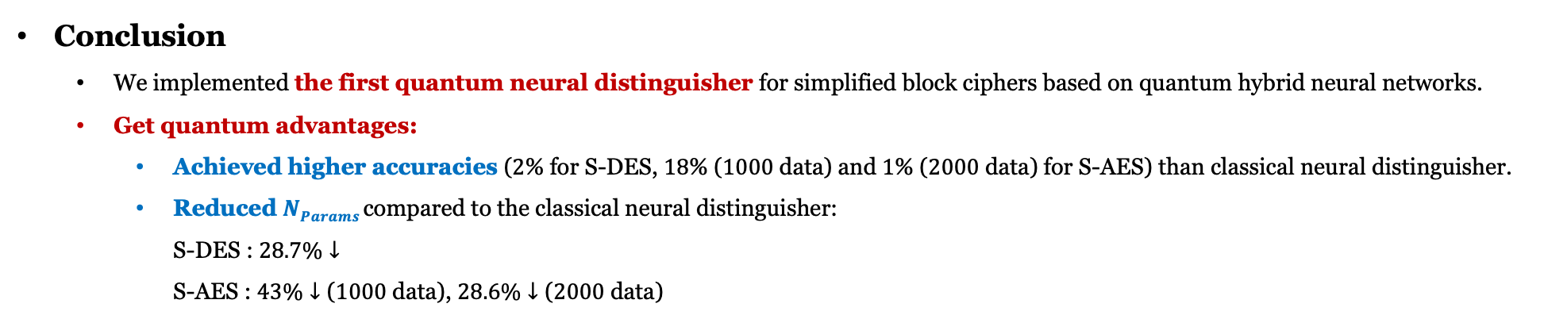
05
Conclusion
Conclusion
We implemented the first quantum neural distinguisher for simplified block ciphers based on quantum hybrid neural networks.
Get quantum advantages:
Achieved higher accuracies ($2$% for S-DES, $18$% ($1000$ data) and $1$% ($2000$ data) for S-AES) than classical neural distinguisher.
Reduced $NParams$compared to the classical neural distinguisher: S-DES : $28.7\%↓$ S-AES : $43\%↓\text{(}1000 \text{data}\text{)}$, $28.6\%↓\text{(}2000 \text{data}\text{)}$
Future work
We will design a distinguisher for other ciphers and multiple input differences.
National Cryptography Contest $2022$

Slide 22
Thank you for your attention!
National Cryptography Contest $2022$

